Slide 1
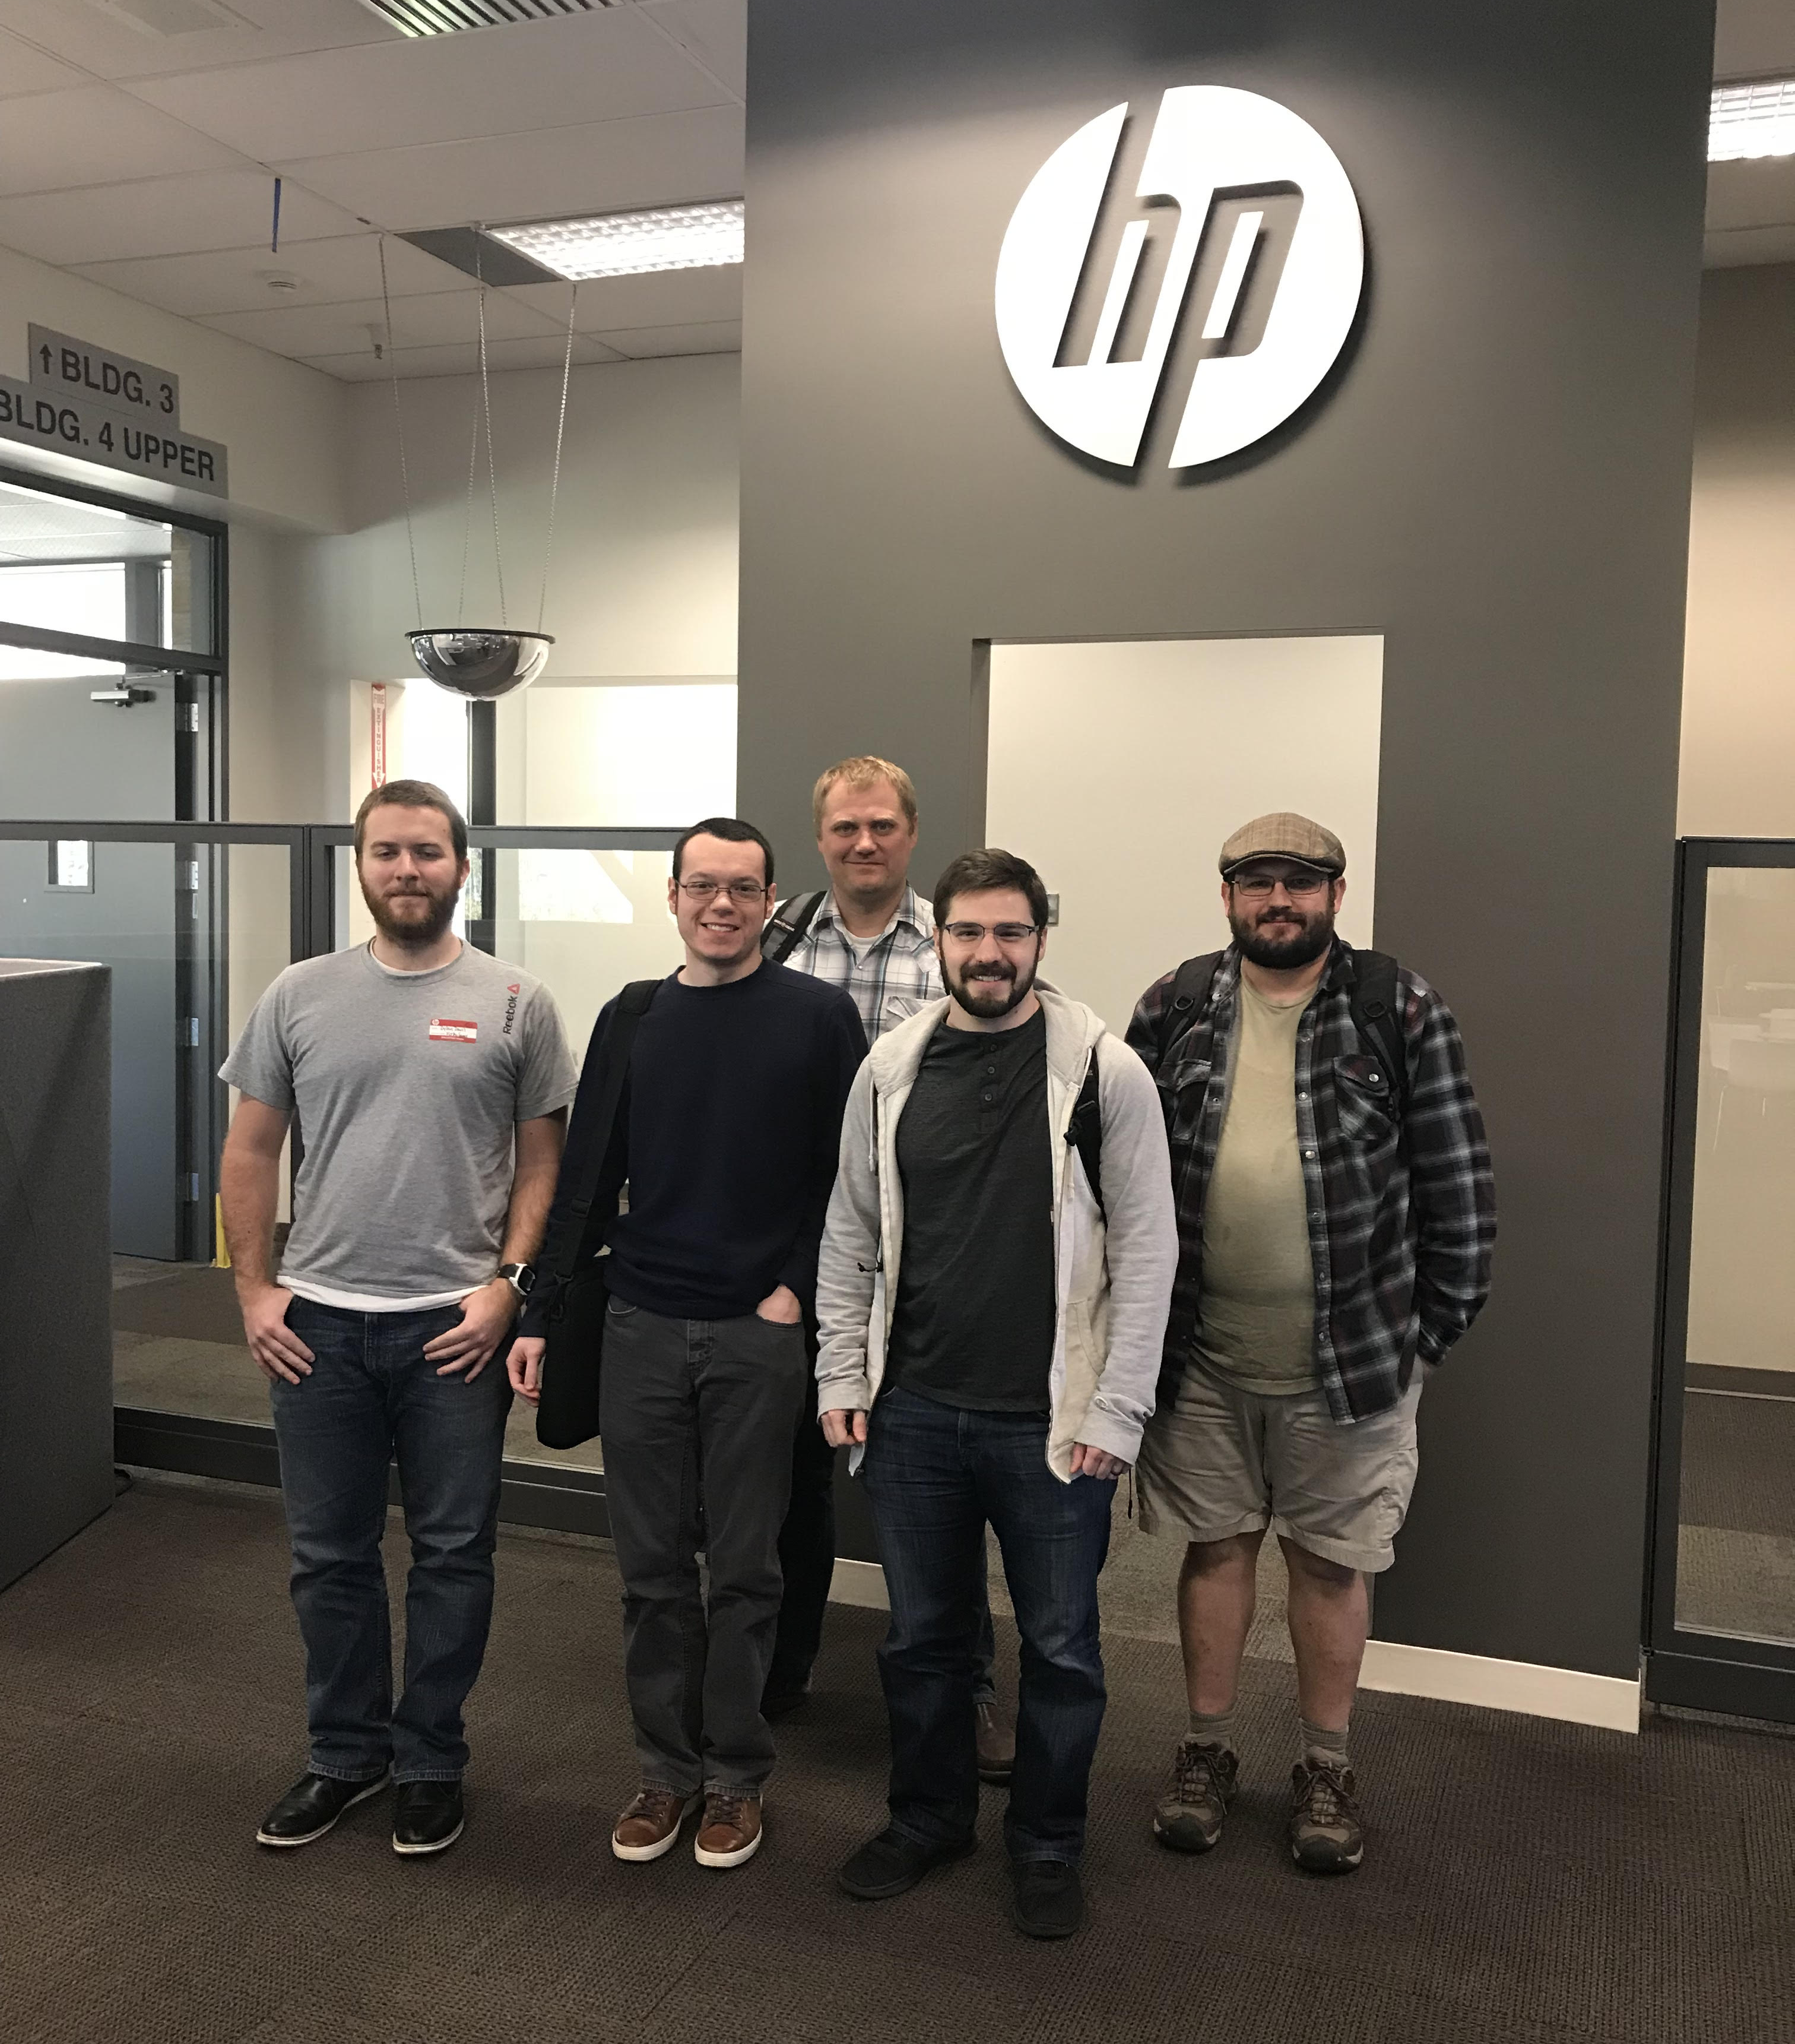
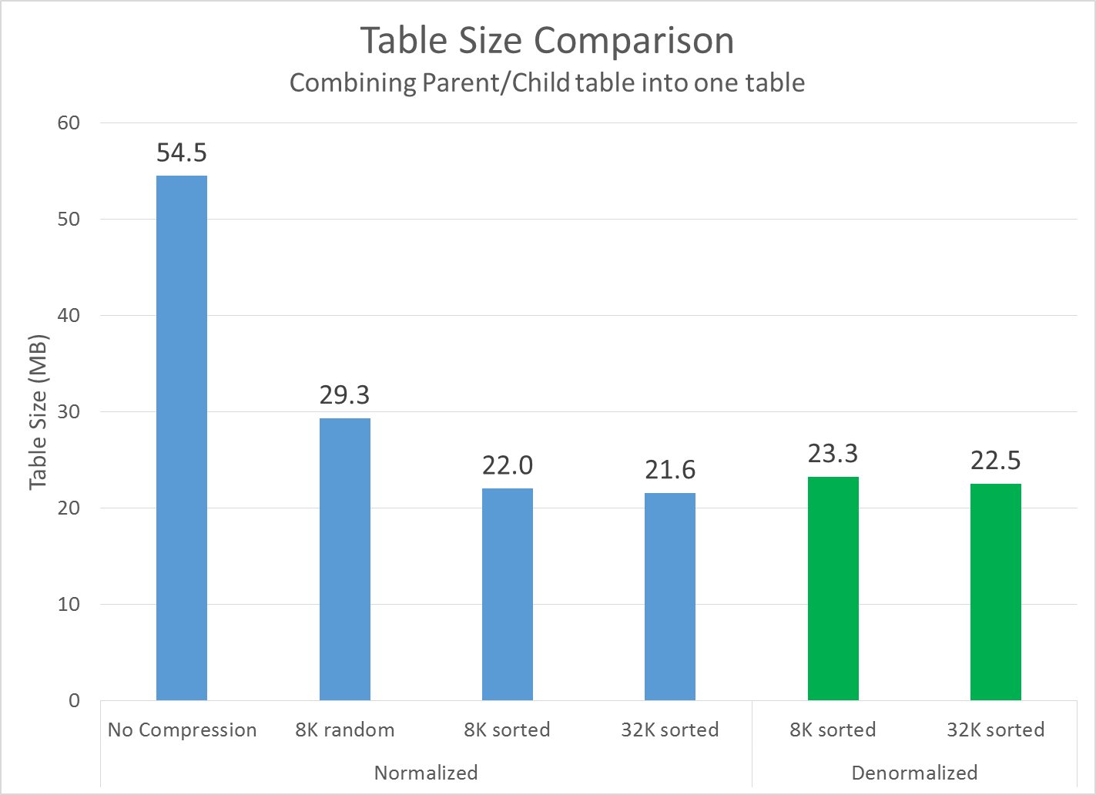
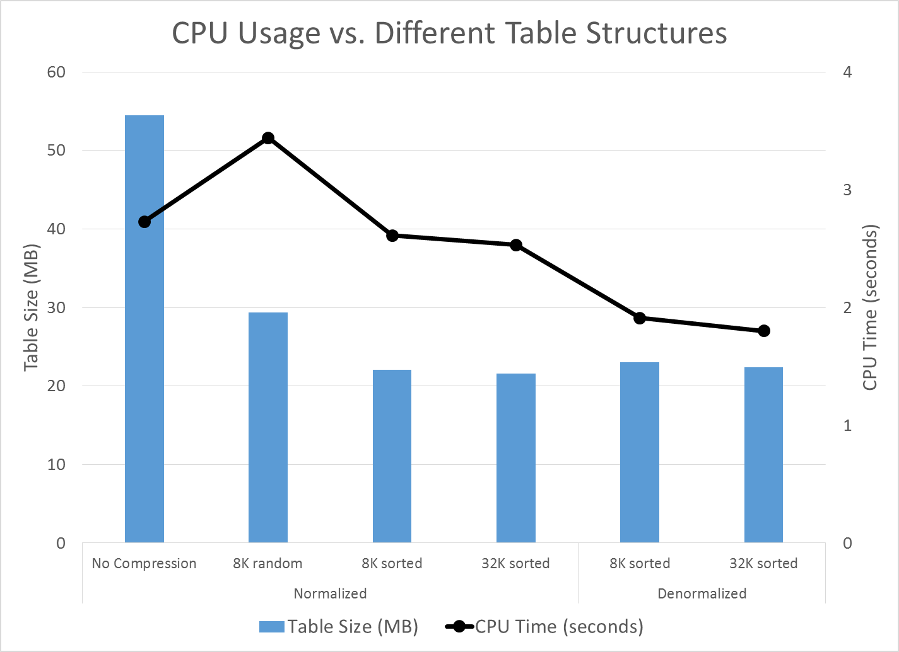
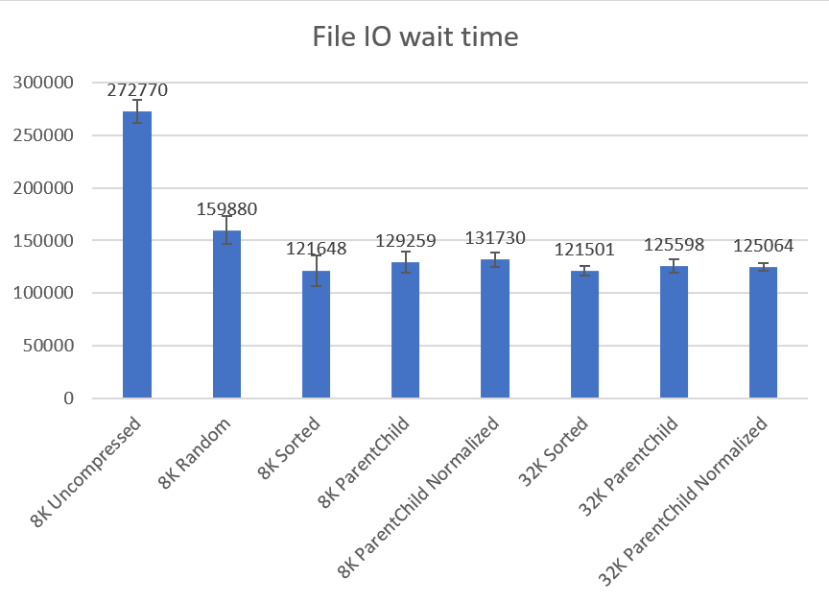
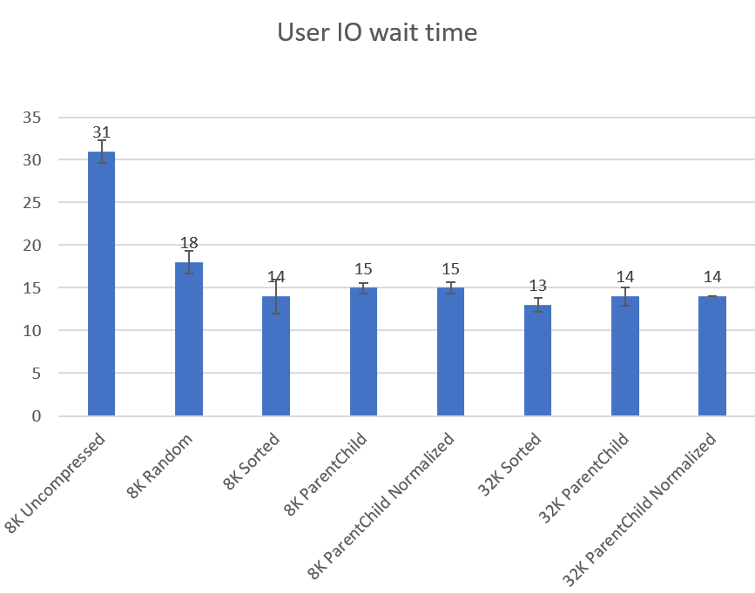
CS18
MOTIVATION
Hp: Big data analytics
The Team
HP’s PageWide Web Press division receives and processes 350GB of data per day
It is critical to effectively use compression to reduce the storage footprint while maintaining, or improving, query performance
Success means improving query and CPU performance, reducing downtime, and preventing an expensive hardware upgrade
Effects of Data Compression
How intelligently inserting data will improve IO and CPU performance in a data warehouse environment
Compressed Data Block
Multicolumn Symbols
0x16:pti[0] nrow=1 offs=0
0x1a:pti[1] nrow=728 offs=1
0x1e:pri[0] offs=0x1f73
...
block_row_dump:
tab 0, row 0, @0x1f73
tl: 13 fb: --H-FL-- lb: 0x0 cc: 1
col 0: [10] 41 41 41 41 41 41 41 41 41 41
bindmp: 02 d8 d2 41 41 41 41 41 41 41 41 41 41
tab 1, row 0, @0x1f6f
col tl: 4 fb: --H-FL-- lb: 0x0 cc: 1
0: [10] 41 41 41 41 41 41 41 41 41 41
bindmp: 2c 00 01 00
...
block_row_dump:
tab 0, row 0, @0x1f5c
tl: 36 fb: --H-FL-- lb: 0x0 cc: 3
col 0: [10] 41 41 41 41 41 41 41 41 41 41
col 1: [10] 42 42 42 42 42 42 42 42 42 42
col 2: [10] 43 43 43 43 43 43 43 43 43 43
bindmp: 02 d0 03 d2 41 41 41 41 41 41 41 41 41 41 d2 42 42 42 42 42 42 42 42 42 42 d2 43 43 43 43 43 43 43 43 43 43
tab 1, row 0, @0x1f58
tl: 4 fb: --H-FL-- lb: 0x0 cc: 3
col 0: [10] 41 41 41 41 41 41 41 41 41 41
col 1: [10] 42 42 42 42 42 42 42 42 42 42
col 2: [10] 43 43 43 43 43 43 43 43 43 43
bindmp: 2c 00 01 00
Research
two tables
COL1
AAAAAAAAAA
AAAAAAAAAA
AAAAAAAAAA
COL1 | COL2 | COL3
AAAAAAAAAA | BBBBBBBBBB | CCCCCCCCCC
AAAAAAAAAA | BBBBBBBBBB | CCCCCCCCCC
Used Oracle Database 12.2 and SQL Developer 17.3 on Oracle Linux to create tables, dump data blocks, and analyze them to see how Oracle’s basic compression algorithm works
Blocks contain the actual data as well as tokens that are used for compression references
Discovered compression is actually deduplication at the block-level,
Found that Oracle reorders columns by cardinality (the amount of unique data)
Created tables with pre-ordered columns, used Snapper to measure CPU and IO
One symbol for three columns
same column,
different lengths
Figure 1. Rows contain same data, but column length differs because duplicate values are replaced with symbols.
Figure 2. Multiple columns can be replaced by a single symbol.
Pictured from left to right:
Dylan Davis: davisdy@oregonstate.edu
Trevor Hammock: hammockt@oregonstate.edu
Kirby Sand: kirby.sand@hp.com
Alex Schultz: schulale@oregonstate.edu
Andy Weiss: andy.weiss@hp.com
Combining Parent/Child Tables
CPU Usage
Details
results
The team began by reverse engineering Oracle’s basic compression algorithm and data blocks. Data compression is actually de-duplication at the block level; tokens are created and used in place of duplicate data, which reduces storage. Once we understood how basic compression works, we created 8 tables that were used to measure performance. Tanel Poder’s Snapper program was used to analyze IO, CPU usage, and time. We concluded that there is a small price to pay for denormalizing data into a combined parent/child table, and CPU usage increases when compressing and utilizing random (unsorted) data. If tables are combined CPU usage decreases because there is no join on the data. Compression is essential and especially performant when the data is sorted.
In essence: compress and sort your data, sort columns from lowest to highest cardinality, and use 32K block sizes.
CPU usage decreases when inserting sorted data versus random data.
IO improves with normalized data compared to denormalized data.
Sorting data significantly improves storage size, and sorting columns from lowest to highest cardinality are very effective
Figure 3. Denormalizing into a combined parent/child comes at a cost, increasing with the parent/child ratio.
Figure 4. More CPU required when decompressing. Combining tables reduces CPU usage.
File IO
User IO
Figure 5. Sort your data and IO will improve.
Figure 6. Once again, sorting data improves IO.

